Slide 1
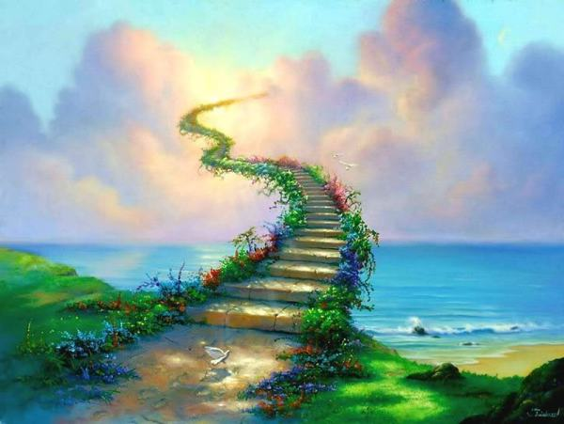
神的道路
The Ways Of God

Slide 2
神的道路
The Ways Of God
词 Lyrics:
以赛亚书 55：9
曲 Composer:
王丽玲
神的道路
The ways of God
高过人的道路
are above that of man.
神的意念
The thoughts God
高过人的意念
are above that of man.
1-1

Slide 3
神的道路
The Ways Of God
词 Lyrics:
以赛亚书 55：9
曲 Composer:
王丽玲
祂的心里有蓝图
He has a plan in His heart
祂的时间不错误
and His timing never fails.
一步一步
Step after step
带领你前途
He will guide your path.
1-2

Slide 4
神的道路
The Ways Of God
词 Lyrics:
以赛亚书 55：9
曲 Composer:
王丽玲
祂立大地的根基，
Earth's foundations He did lay,
祂让云彩空中漂浮，
clouds in the sky He placed to play.
是祂创造生命气息，
He created the breath of life,
是祂应许照顾赐福，
promises of blessings us He gave.
1-3

Slide 5
神的道路
The Ways Of God
词 Lyrics:
以赛亚书 55：9
曲 Composer:
王丽玲
神造万物各按其时，
God created all in His time,
耐心等待必要欢呼，
those who wait on Him shall rejoice.
啊！耐心等待要欢呼。
Ah! Those who wait on Him shall rejoice.
1-4

Slide 6
神的道路
The Ways Of God
词 Lyrics:
以赛亚书 55：9
曲 Composer:
王丽玲
神的道路
The ways of God
高过人的道路
are above that of man.
神的意念
The thoughts God
高过人的意念
are above that of man.
2-1

Slide 7
神的道路
The Ways Of God
词 Lyrics:
以赛亚书 55：9
曲 Composer:
王丽玲
祂的心里有蓝图
He has a plan in His heart
祂的时间不错误
and His timing never fails.
一步一步
Step after step
带领你前途
He will guide your path.
2-2

Slide 8
神的道路
The Ways Of God
词 Lyrics:
以赛亚书 55：9
曲 Composer:
王丽玲
祂立大地的根基，
Earth's foundations He did lay,
祂让云彩空中漂浮，
clouds in the sky He placed to play.
是祂创造生命气息，
He created the breath of life,
是祂应许照顾赐福，
promises of blessings us He gave.
2-3

Slide 9
神的道路
The Ways Of God
词 Lyrics:
以赛亚书 55：9
曲 Composer:
王丽玲
神造万物各按其时，
God created all in His time,
耐心等待必要欢呼，
those who wait on Him shall rejoice.
啊！耐心等待要欢呼。
Ah! Those who wait on Him shall rejoice.
2-4

Slide 10
神的道路
The Ways Of God
词 Lyrics:
以赛亚书 55：9
曲 Composer:
王丽玲
祂立大地的根基，
Earth's foundations He did lay,
祂让云彩空中漂浮，
clouds in the sky He placed to play.
是祂创造生命气息，
He created the breath of life,
是祂应许照顾赐福，
promises of blessings us He gave.
3-3

Slide 11
神的道路
The Ways Of God
词 Lyrics:
以赛亚书 55：9
曲 Composer:
王丽玲
神造万物各按其时，
God created all in His time,
耐心等待必要欢呼，
those who wait on Him shall rejoice.
啊！耐心等待要欢呼。
Ah! Those who wait on Him shall rejoice.
3-4

